Slide 1
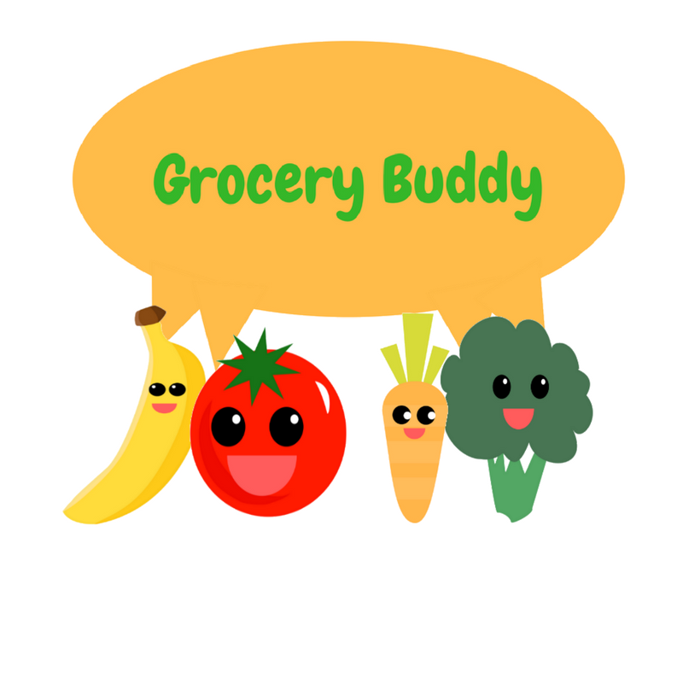
Grocery Buddy
By Ecoders (Patrick, Raly, Kevin, Toni, and Carlo)

Slide 2



What Does It Do?
Grocery Lists
Check off items as you go
Save lists for future reference
Fridge Tracking
Show how long food has until it expires
See what’s going to expire right away

Slide 3



Where we left off:
Source code ported
Database implemented
Website hosted
Log-in/Log-out added
Easter egg included
Many bugs fixed

Slide 4

Sprint 3 Goals
Clean up/add UI features
Expiration functions
Database entry
Predictive text
Fix as many bugs as possible!

Slide 5
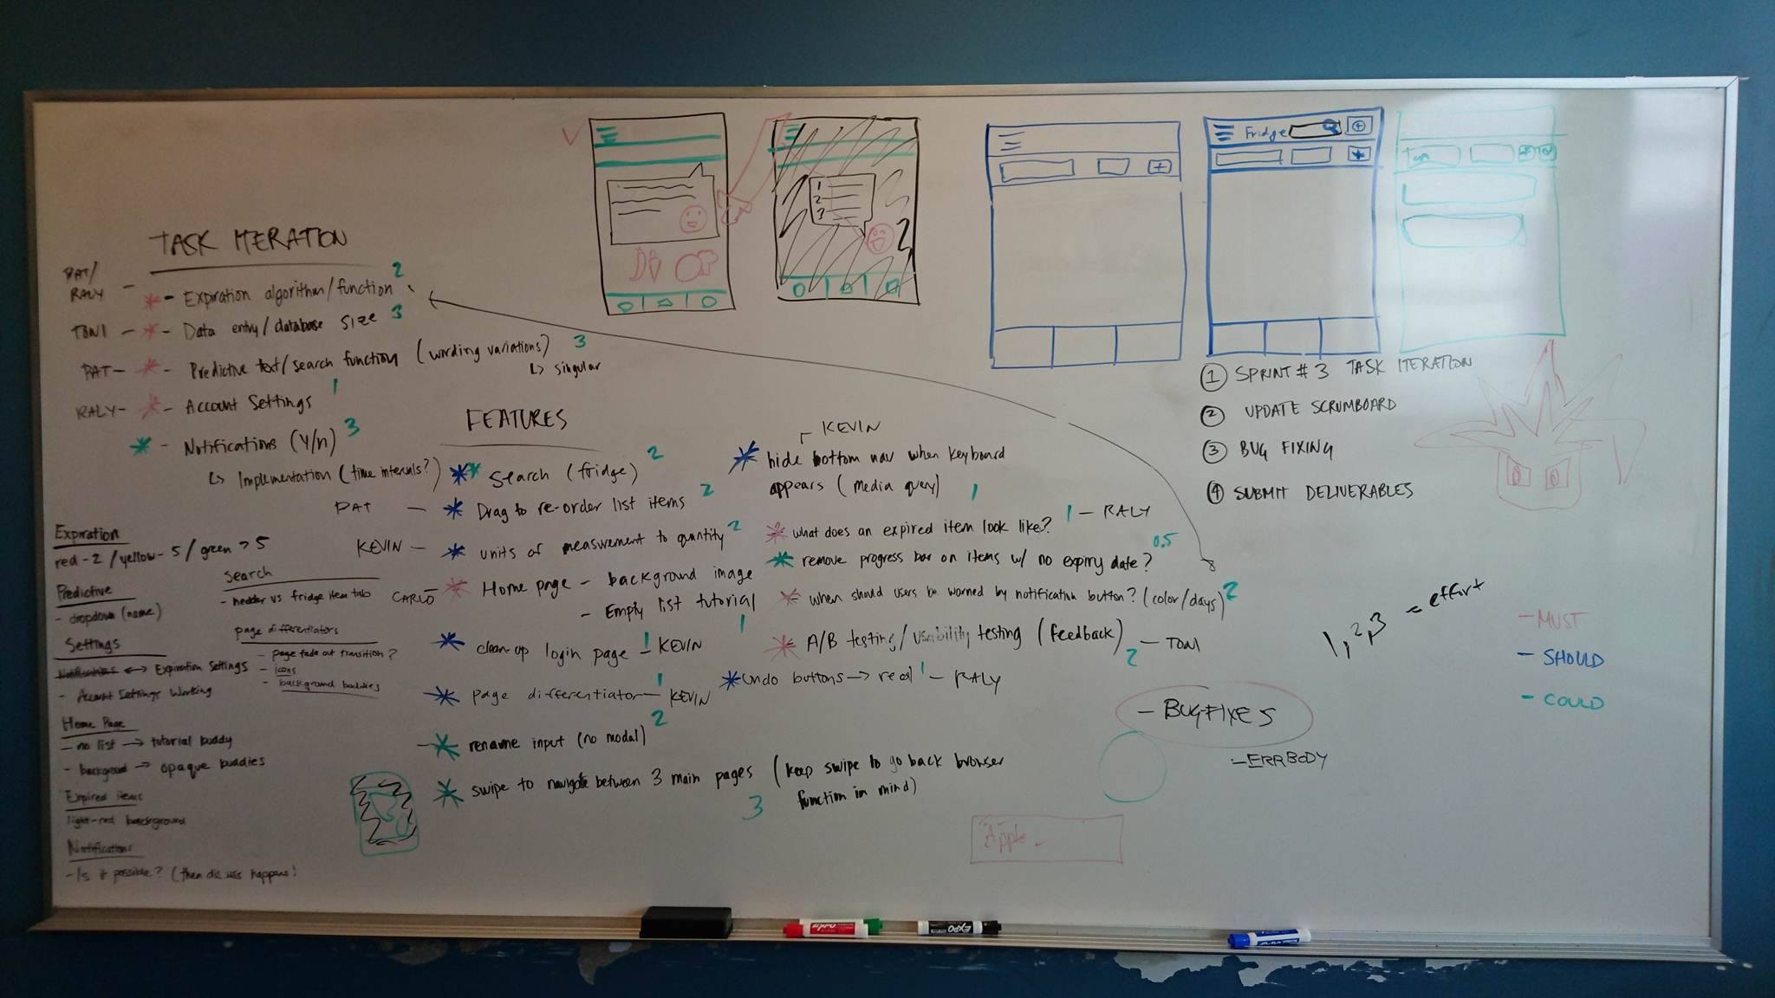
Planning Process

Slide 6
Sprint 3 Challenge:
Connect our app to social media
Twitter or Facebook messages
Let users log in using Google or other social media ID
Notes:
So we got the challenge on Sunday night, and the goal is to connect our webapps with social media.
For this challenge we already thought ahead and implemented Google authenticated signin.
We thought Twitter / Facebook are most appropriate for this challenge, so we’re gonna work on implementing that.

Slide 7
Task assignments:
Kevin – clean up UI/implement new UI features
Toni – database entry, A/B testing, usability testing, challenge #3
Raly – settings, expiration tracking
Patrick – expiration algorithm, predictive text, search functions, drag to reorder items
Carlo – background images, helper graphics for new users

Slide 8

Sprint 2 Scrumboard:
Alt + Tab!

Slide 9


Conclusion
THANKS!

